Slide 1

AFIO
CLINICAL PLATFORM
AI-Assisted Ophthalmic
Screening Platform
Faster detection. Greater consistency. More time for patient care.
OCT Analysis
Retinal Screening
VKG
Corneal Ulcer
PROJECT DEMONSTRATION

Slide 2




THE CHALLENGE
Every Delayed Diagnosis Has Consequences
Time Pressure
Subtle Early Signs
Inconsistent Reports
Vision Loss
Observer Variability
Rising Patient Volumes
Earlier detection can preserve vision
AFIO
02

Slide 3

CONSIDERED & REJECTED
Existing Options Fall Short
Generic AI Tool
One App Per Disease
Manual-Only Screening
Not built for these
specific conditions
3 logins,
3 learning curves
Specialist-dependent,
doesn't scale
None of these were good enough. So, we built something else.
AFIO ScanAI
04 / 12
Notes:
Before building this, we looked at what already exists. A generic AI screening tool isn't trained for these specific conditions. Building three separate applications means a technician has to learn three different systems — unrealistic in a busy hospital. And staying fully manual doesn't scale — you stay dependent on a small number of specialists. None of these were good enough, so we built something else.

Slide 4
What if
Every Retinal Scan Had
an Instant AI-Clinical Assistant?
Immediate Analysis
Risk Prioritization
Reviews every retinal image immediately after
capturing and delivering results in seconds.
Prioritizes high-risk cases for faster clinical attention,
so the most urgent patients are never missed.
Clinician Focus
Consistent Assessment
Allows clinicians to dedicate more time to patients who
need it most, not routine reviews.
Delivers standardized, fatigue-free first-pass analysis,
Every scan, every time.
AI supports the clinician, it never replaces the clinician.

Slide 5



Five Diseases, Five Different Problems (dk what else to do in this slide, delete if u feel like)
OCT
Glaucoma
Corneal Ulcer
Cross-sectional imaging of retinal layers for detailed eye analysis.
Silent optic nerve damage.
No early symptoms.
Infection or damage to the cornea evaluated with slit-lamp examination.
DR / HR
VKG
Blood vessel damage caused by Diabetes and Blood Pressure
Assesses glaucoma risk using the optic nerve cup-to-disc ratio.

Slide 6



AI- Models
Our 4 Models
~97%
>90%
~92.6%
??
OCT Analyzer
Retinal Screening
VKG / Corneal
Corneal Ulcer
CNV · DME · DRUSEN · NORMAL
DR · GLAUCOMA · HYPERTENSIVE
KERATOCONUS RISK ASSESSMENT
ANTERIOR SEGMENT SCREENING
Classifies retinal OCT scans into four major disease categories with Grad-CAM attention visualization.
Fundus photograph screening for diabetic retinopathy, glaucoma risk, and hypertensive retinopathy.
Corneal topography analysis for keratoconus and corneal disease risk, enabling earlier intervention.
Slit-lamp image analysis for corneal ulcer pattern detection, supports triage in urgent cases.

Slide 7
OUR SOLUTION
One Interface. Three Engines.
ONE COMMON UI
RetinalAI
OCT Analyzer
VKG
DR · Glaucoma · HR
4-class OCT screening
Corneal · Keratoconus
One face. One dashboard. Three individual solutions underneath.
AFIO ScanAI
05 / 12
Notes:
AFIO ScanAI is one common interface, with three purpose-built AI engines running underneath it — RetinalAI, OCT Analyzer, and VKG. To the technician, it's one login, one dashboard, one workflow. Underneath, each engine is independently trained for its specific disease. One face. Three individual solutions.

Slide 8

CLINICAL WORKFLOW
This is how ScanAI works
Upload Image
AI Analysis
Grad-CAM Heatmap
Approved Report
Doctor Review
Draft Report
AFIO
03

Slide 9
WHY THIS MATTERS
The Number That Matters Most
TRADITIONAL
WITH ScanAI
20–30 min
~3 min
per patient, with a specialist
per patient, with a technician
Specialist reviews every patient
Specialist reviews only flagged cases
An ophthalmologist can review 10x more patients with AI-assistance
AFIO ScanAI
09 / 12
Notes:
This is the number that matters most. A traditional specialist-led screening takes twenty to thirty minutes per patient. With AFIO, a technician screens a patient in about three minutes, and the specialist only needs to personally review the cases the AI flags — not every patient. In practice, that means a clinic could screen up to ten times more patients in a single day, without needing ten times the specialist staff.

Slide 10
THE TECHNOLOGY, IN PLAIN TERMS
The AI Behind the scenes
RetinalAI
OCT Analyzer
VKG
98%
97%
92.6%
Fundus photographs
OCT scans
Corneal imaging
DR · Glaucoma · HR
4-class classification
Keratoconus screening
Trained on public research datasets (Kaggle) + institutional data. Internal evaluation results, local validation is next.
AFIO ScanAI
08 / 12
Notes:
In plain terms — each model is shown thousands of labeled example images, some healthy, some diseased, until it learns the visual patterns doctors look for. It's then tested on images it's never seen, to check it generalizes rather than memorizes. RetinalAI reaches up to 98% accuracy on fundus photographs, the OCT Analyzer 97% on OCT scans, and VKG 92.6% on corneal imaging. Training data came from public research datasets combined with what we could source institutionally. These are strong internal evaluation results — real hospital data, which we'll get to, is the next step to confirm them locally.

Slide 11




PROPOSED PARTNERSHIP
What We Need From AFIO
De-identified patient images
Ophthalmologist feedback
Pilot deployment
Standard hospital laptop
for local population validation
on sample AI predictions
one OPD, 4–8 weeks
no GPU required
AFIO ScanAI
11 / 12
Notes:
To move this from research to clinic, we're proposing a partnership, not asking for a favor. We'd need de-identified patient images to validate the models specifically on the local population — our current data is largely public datasets. We'd need your ophthalmologists' feedback reviewing sample predictions, which directly improves the system. And we'd need a pilot in one OPD for four to eight weeks, under your supervision. Technically, this is lightweight — it runs on a standard hospital laptop with internet access, no GPU or special hardware. In return, AFIO gets early access to a validated screening tool built specifically on Pakistani clinical data.

Slide 12
Thank You
RM
RS
KB
MA
Raahym Mustafa
Rafay Shahzad
Khadija Bibi
Mashal Areej
AS
MA
Zu
Arsal Saeed
Malik Ahmed
Zain ul Abidin
“AI doesn’t replace ophthalmologists.
It ensures no patient falls through the cracks.”
Notes:
That's our team, and I'll remain your point of contact for any feedback or pilot coordination going forward — my details are on screen. To close: AI doesn't replace your ophthalmologists' judgment. It makes sure no patient falls through the cracks because of time or distance. Thank you, sir — we're glad to take any questions.

Slide 13
05. PATIENT OUTCOMES
Earlier Detection. Earlier Treatment. Better Vision.
Faster Screening and Reporting
Reduced Missed Pathology
Patients receive AI-assisted results within seconds of image capture.
AI second opinion reduces the likelihood of subtle findings being
overlooked.
Secure Digital Reports
Physician-Reviewed Results
Encrypted, easy-to-access reports that patients and care teams can
share securely.
Patients gain confidence knowing AI findings are always reviewed and
validated by an ophthalmologist.
The goal isn't faster technology. It's better patient care.
AFIO
06

Slide 14
09. OUR VISION
Making Early Eye Disease
Detection Accessible to Everyone
01
Timely Screening for Every Patient
02
Preventable Blindness Becomes Rare
A future where every patient receives screening when they
need it, not when a slot becomes available.
Better detection rates mean fewer cases of avoidable vision
loss reaching irreversible stages.
03
AI Expands Clinical Capacity
04
Technology Empowers Clinicians
Scaling screening programs without a proportional increase in
specialist workload or overhead.
Tools that amplify clinical expertise rather than replacing the
human judgment at the heart of care.
More patients screened. Earlier diagnoses. Better lives.
AFIO
10

Slide 15
06. EXPLAINABLE AI
Transparency Builds Trust
AFIO explains every prediction — not just the result.
Visual Heatmaps
Evidence-Backed Predictions
Clinician Validation
Highlights suspicious retinal regions
using visual heatmaps that show
exactly where the AI detected
anomalies.
Shows the evidence supporting
each prediction, giving clinicians the
context to understand AI reasoning.
Allows clinicians to review and
validate every AI finding before any
decision is made or report issued.
An explainable AI is an AI clinicians can trust.
AFIO
07

Slide 16

OCT ANALYZER
Retinal layer classification — four categories, one scan.
CNV
DRUSEN
~97%
Choroidal Neovascularization
Drusen Deposits
Abnormal vessel growth under the retina — associated with wet AMD. Can leak fluid, causing rapid central vision loss.
Lipid deposits under the retina associated with AMD risk and retinal aging. A key early warning marker.
Classification Accuracy
(internal evaluation)
DME
NORMAL
Diabetic Macular Edema
Normal OCT
+ Grad-CAM
Every prediction comes with a visual heatmap showing which region of the OCT scan influenced the result. The doctor checks the highlighted area — not a black-box label.
Fluid leakage in the macula from diabetic complications. Directly threatens central vision if unmanaged.
No major pathological pattern identified within the trained classification scope.
AFIO
04

Slide 17

RETINAL SCREENING
Three high-impact conditions. One fundus photograph.
No DR
Mild
Moderate
Severe
Proliferative
DIABETIC RETINOPATHY SEVERITY SPECTRUM
>90%
>90%
>90%
DR MODEL ACCURACY
GLAUCOMA MODEL ACCURACY
HR MODEL ACCURACY
Diabetic Retinopathy
Glaucoma (CDR)
Hypertensive Retinopathy
One of the leading causes of preventable blindness. AFIO screens for DR severity patterns to help prioritize which patients need urgent retinal specialist review.
Fundus images reveal optic disc and cup-to-disc ratio changes that indicate glaucoma risk — critical since glaucoma can progress silently before vision loss is noticed.
Retinal vessel changes from chronic hypertension — narrowing, hemorrhages, vascular irregularities — can indicate broader cardiovascular risk beyond the eye.
Proliferative DR flagged for emergency review
Suspicious CDR patterns highlighted for review
Vascular changes flagged with Grad-CAM map
AFIO
05

Slide 18
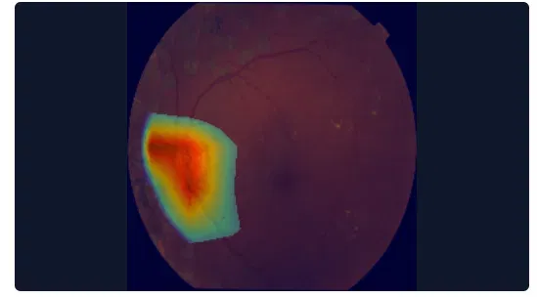
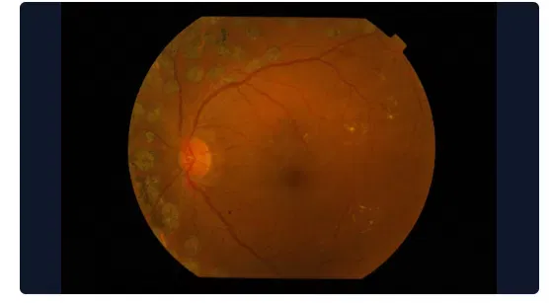

EXPLAINABILITY
Why did the AI flag this image? The doctor can see exactly why.
Hot Zones (Red / Orange)
Region that most influenced the prediction. Doctor checks this area first.
Warm Zones (Yellow)
Secondary attention — contributing but not dominant to the output.
ORIGINAL SCAN
GRAD-CAM OVERLAY
Not a Diagnosis
Cool Zones (Blue / Green)
The heatmap shows model attention, not a clinical measurement. Always requires doctor review.
Low influence. Background or clinically less significant for this prediction.
Black-box AI isn’t clinically usable. Grad-CAM makes every prediction reviewable and transparent — the doctor sees what the model saw.
AFIO
06

Slide 19



REPORT GENERATION
From scan to structured clinical report in one click.
AFIO · CLINICAL SCREENING REPORT
DRAFT
Zero Writing From Scratch
The draft report auto-populates with AI result, findings, impression, and recommendation. Doctor edits, not writes.
PATIENT
MCS-RETINA-0004 — Arsal Saeed | 29 / Male
SCAN TYPE
Structured & Consistent
Retinal Fundus | Right Eye | 7/23/2026
All reports follow the same clinical format — easier follow-up, audit, and patient history review.
AI RESULT
PROLIFERATIVE_DR
Confidence 91%
FINDINGS
Doctor Has Final Say
Combined fundus screening shows features concerning for proliferative diabetic retinopathy. Glaucoma and hypertensive retinopathy outputs should be reviewed in the result summary.
Every field is fully editable. Only a doctor can mark a report as Approved. Draft watermarks remain until then.
IMPRESSION
Fundus screening suggests proliferative diabetic retinopathy.
RECOMMENDATION
Download & Archive
Emergency / urgent retinal specialist review advised after clinician confirmation.
Reports export as PDF with Grad-CAM heatmap embedded. Patient access code for secure lookup.
DOCTOR NOTES
[ Editable by attending physician ]
Needs clinical correlation ▾
Download PDF
AFIO
07

Slide 20
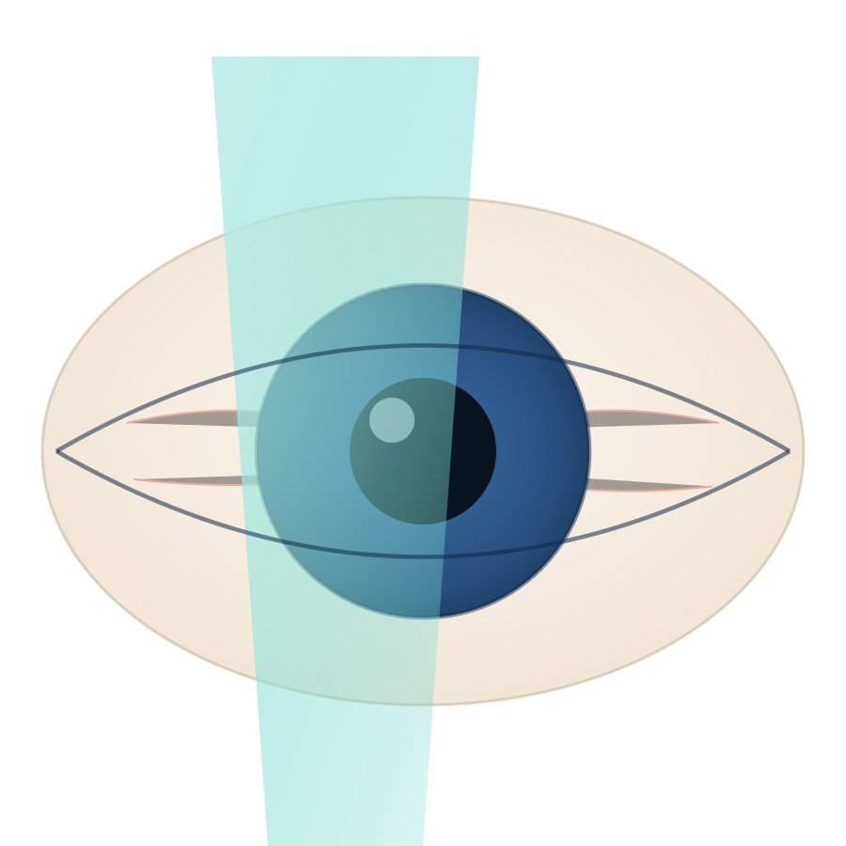
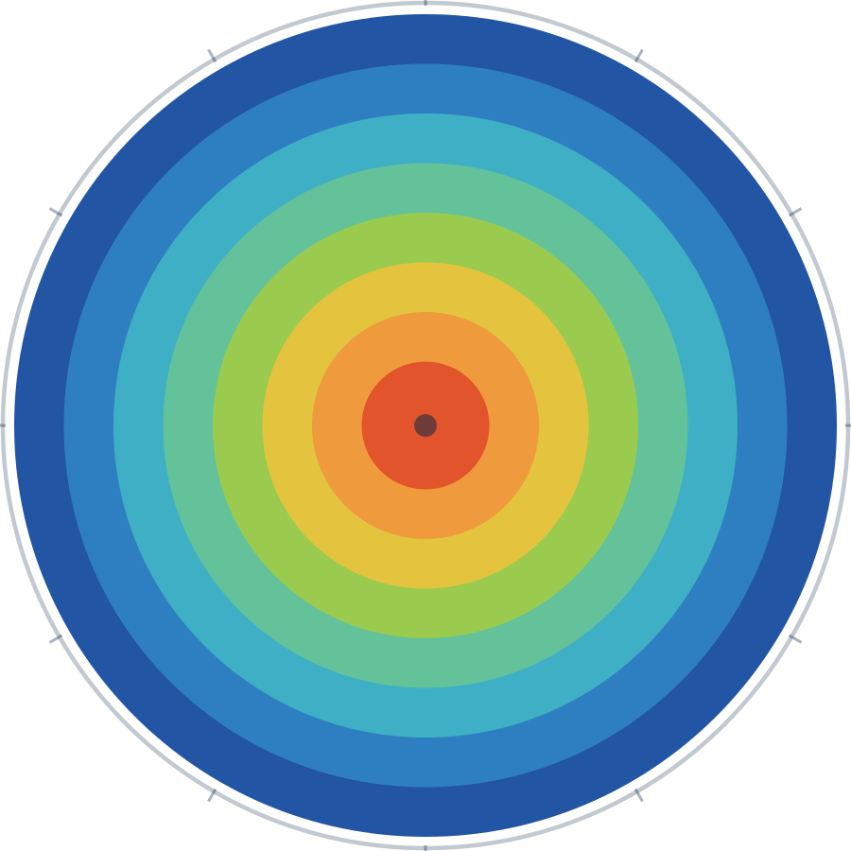
CORNEAL MODULES
Beyond the retina — corneal disease screening and ulcer triage.
Corneal Ulcer Screening
VKG / Corneal Topography
NEW
~92.6%
TARGET CONDITION
TARGET CONDITION
Corneal ulcer patterns — infectious, traumatic, contact-lens related, dry eye complications
Keratoconus and related corneal shape abnormalities
INPUT
INPUT
Slit-lamp anterior segment photographs
Corneal topography maps
HOW IT WORKS
HOW IT WORKS
Classifies slit-lamp images for ulcer pattern signatures and returns an AI-assisted first-pass impression to speed triage and documentation.
Analyses topography maps for curvature patterns indicating progressive thinning and forward bulging of the cornea.
WHY EARLY MATTERS
WHY EARLY MATTERS
Corneal ulcers can progress rapidly — scarring, vision loss, or perforation in severe cases. Triage speed matters.
Keratoconus progresses over time — earlier detection enables monitoring, collagen crosslinking referral, or lens-fitting adjustment.
CLINICAL OUTPUT
CLINICAL OUTPUT
Risk grade (normal / suspicious / high risk) with draft report and referral recommendation.
Risk grade (normal / suspicious / high risk) with referral recommendation for crosslinking or lens-fitting.
STATUS
STATUS
Newly integrated module — part of platform expansion into anterior segment workflows.
~92.6% accuracy · AUC ~0.9775 — strong discriminative performance in internal evaluation.
AFIO
08

Slide 21





CLINICAL WORKFLOW
Patient in. Approved report out. Every step visible.
01
02
03
Patient Registered
Image Uploaded
AI Analysis Runs
Name, ID, age, gender entered. Assigned a unique patient code per module (e.g. MCS-OCT-0001).
OCT scan, fundus photo, topography map, or slit-lamp image uploaded directly in the browser.
Backend model processes the image. Confidence score and disease classification returned within seconds.
04
05
06
Grad-CAM Generated
Draft Report Created
Doctor Reviews & Approves
Attention heatmap overlaid on the original image. Suspicious region highlighted for doctor attention.
Findings, impression, and recommendation auto-populated from the template. Fully editable before saving.
Doctor edits, adds clinical notes, sets final diagnosis, and approves. Report is then downloadable as PDF.
The doctor is involved at every stage. AI assists — it does not operate independently.
AFIO
09

Slide 22
MODEL PERFORMANCE
Internal evaluation results — strong technical foundation.
~97%
>90%
~92.6%
98%
OCT Classifier Accuracy
Retinal Screening Accuracy
VKG / Corneal Accuracy
OCT Module Avg Confidence
4 categories: CNV, DME, Drusen, Normal
DR, Glaucoma, Hypertensive — each model
AUC ~0.9775 — strong discriminative power
Live platform stats — 97 scans, 13 patients
WHAT AUC MEANS
Next Clinical Step
AUC (Area Under Curve) measures how well the model separates diseased from non-diseased cases. An AUC of 0.9775 (max 1.0) indicates the VKG model is strongly reliable at distinguishing keratoconus-risk cases from normal corneas.
These are internal model evaluation results and show strong technical feasibility. Larger hospital-based validation is the next step before full deployment.
AFIO
10

Slide 23




DEPARTMENT IMPACT
What this means for your department.
Ophthalmologist
OPD / Screening Camp
Spend more time on clinical judgment, less on documentation
First-pass AI screening identifies priority cases in seconds
Grad-CAM draws attention to suspicious regions immediately
Final approval authority — nothing publishes without sign-off
Batch patient workflow — registration, upload, reports queued
Full editorial control — every report editable and approachable
Reduce bottleneck at peak patient volumes
Digital record keeping — searchable by patient ID, CNIC, diagnosis
Junior Staff / Residents
Hospital Administration
Structured report templates teach standard clinical language
Grad-CAM attention maps show what experienced models look for
Draft reports editable before senior review — not blank pages
All reports go through doctor approval — training safety net
Consistent report format across all doctors and shifts
Dashboard analytics — patient volume, scan counts, approvals
Downloadable PDFs for patient records and referral letters
Audit trail — every draft and approval timestamped
AFIO
11

Slide 24


“AI should support the ophthalmologist, not replace them.”
Reduce load. Improve consistency. Provide clearer reports. Give doctors more time for clinical judgment.
FUTURE ROADMAP
Severity grading for DR
Progression tracking over time
Bilingual report output
Voice-based report editing
Batch upload for camps
HIS / EMR integration
MILITARY COLLEGE OF SIGNALS · NUST | Final Year Project — AI-Assisted Ophthalmic Clinical Workflow
AFIO
12

